Slide 1
Treasurers

Slide 2
The Role of a Treasurer
Treasurers Workshop
Treasurers

Slide 3
General Duties
Take care of financial transactions involving the school ASB
Attend all events, meetings, Kiwanis meetings, and division/district events
Manage club budget and finances
Ensure that dues are paid, collected, and sent in
Plan fundraisers
Train the treasurer-elect
Treasurers

Slide 4
Communicate!
Communicate and work with the club board:
Create an annual budget
Organize fundraisers
Communicate with the school ASB to handle money throughout the year
Communicate with advisors to physically handle money at events and fundraisers
Motivate and inspire members to contribute
Keep all files and records for future use
Treasurers

Slide 5
Fundraising
Treasurers Workshop
Treasurers

Slide 6
Fundraise & Finance
Plan and organize golden fundraisers for:
PTP, Eliminate Project, Club Dues, Fall Rally, DCON, ICON
Put in ASB Requests for fundraisers as early as possible
Collect, count, record, and store money with adult supervision and help
Record revenue v. expense; Keep all receipts
Provide financial status updates to the club, advisors, and Kiwanis
Treasurers

Slide 7
TIPS FOR SUCCESS
Make sure people know what you’re fundraising for
Be excited about fundraising! Show your Key Club spirit, and your stunning smile. Be confident!
Publicize fundraisers with available resources
Morning Announcements, Bulletins, Posters, Flyers, Emails, Social Media, etc…
Make sure your publicity is eye-catching!
Create a budget for your fundraisers, calculate expenses, and calculate net profit
Work with businesses, other organizations, and the school to raise more money or spread publicity
Treasurers

Slide 8
Handling Money
Never handle money by yourself!
Make sure an adult (advisor or parent) is there to either supervise or handle the money themselves
Designate an adult before fundraisers, so no last minute crises occur

Slide 9
Dues Payment
Treasurers Workshop
Treasurers

Slide 10
Dues!
The Basics
Work with Club Secretary to manage membership dues!
Collect and record membership dues!
Promote membership! (Club Rush ALL YEAR!)
Collaborate with club advisor to register members into the online Membership Update Center
Treasurers

Slide 11
Defining Dues
Membership card & pin
Administrative budget
International Officers and Board
Youth Opportunities Fund
$6.50
International
Administrative Budget
District Officers and Board
Committee Budgets
Senior Scholarships
$4.50
District
Treasurers

Slide 12
There is no such thing as maximum membership
Dues are annual! Members must renew their membership every year
Dues are meant to come back to the membership, through the leadership and service opportunities, YOF grants, senior scholarships, and priceless memories. They are worth it!
Treasurers

Slide 13
Payment Process
Create a club roster with the Secretary, and collect dues with the advisor
Start early, and explain why members should pay dues.
You can fundraise to help members pay dues.
Record and deposit finances into your club account (usually with school ASB)
Register members with advisor on the Membership Update Center (MUC)
Treasurers

Slide 14
Withdraw dues money appropriately from the account
Generate an invoice on the MUC
Mail both invoice and check to:
Key Club International PO Box 6069 – Dept. 123 Indianapolis, IN 46206-6069
Treasurers

Slide 15
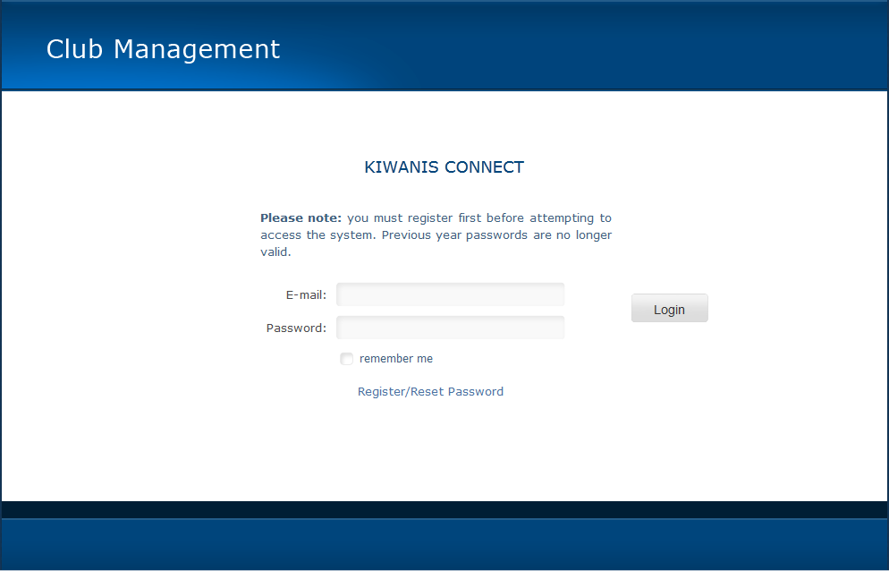
MUC Walkthrough
With your faculty advisor, go to:
www.keyclub.org/MUC/
Register password (emailed to advisor)
If necessary, reset the password by clicking on the appropriate link and entering the faculty advisor’s email
Treasurers

Slide 16
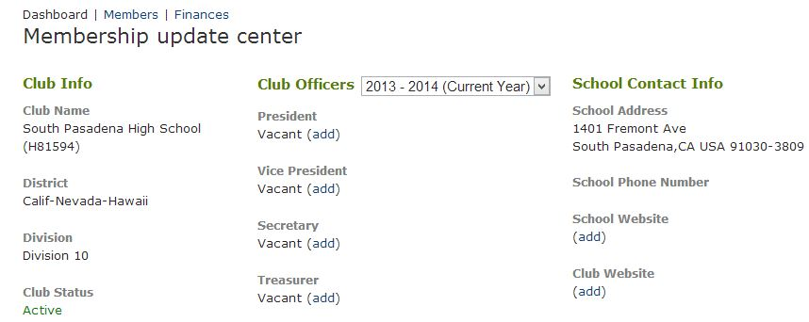
Ensure that all club, officer, and advisor information is correct for the new year before updating the roster
Treasurers

Slide 17
Update the club roster by adding and deleting members as necessary
When complete, print the computer generated invoice
This is what you will send out with a check when you are mailing in dues
Treasurers

Slide 18
Deadlines
All dates are received by deadlines
Early bird is not awarded by the district anymore
Clubs that have not paid by September 30th will have their charter revoked.
First Payment Date | October 1st, 2013
Early Bird Dues | November 1st, 2013
Regular Dues | December 1st, 2013
Dues Become Delinquent | December 2nd, 2013
Dues Recognition/Suspension | February 1st, 2014
Treasurers

Slide 19
Troubleshooting
If your advisor does not receive a password after “registering/reset” please email Key Club International at memberservices@kiwanis.org or call at 1-800-549-2647
Provide your Club ID Number (H######)

Slide 20
Awards Grants & Scholarships
Treasurers Workshop
Treasurers

Slide 21
Awards
Achieved Increased Membership (A.I.M)
This award is based on dues standings from February 1st. Clubs either increasing by 25, 50, 100% will receive a banner patch at District Convention. No forms are needed because records are based from International.
Membership Retention Award
This award is based on whether or not your club has retained the membership count from the year previous. Again, no forms are needed because records are based from International.
Treasurers

Slide 22
Grants
Youth Opportunities Fund
YOF is a fund from KC International that assists in paying for large projects through grants.
Clubs can apply for grants ranging from $200 up to $2000.
ALL grants must be turned in by October 15th!
CNH PTP Grant
CNH offers grants for PTP projects
Up to $250 in grant money
Links provided in the Resources slide
Treasurers

Slide 23
Scholarships
Available to all members and officers
To qualify, you must be a dues paid Key Club member that year
Application forms will be available on the Cyberkey as DCON approaches
District scholarship winners announced at DCON
Promote these to graduating seniors
Treasurers

Slide 24
Additional Resources
On the CyberKey
Treasurers Manual
Dues Guide
And much more http://www.cnhkeyclub.org/officers/treasurer
Key Club International
http://www.keyclub.org/Leadership/bal/leadclub/Clubtreasurer.aspx
Treasurers Google Reflector
Advisors, Lt. Governors, and Executive Officers
Treasurers

Slide 25
YOF Grants:
http://keyclub.org/service/fund/yof/yofgrant.aspx
CNH PTP Grants:
http://cnhkeyclub.org/downloads/Resources/Kiwanis%20Family/SLP%20PTP%20Grant%20Application.pdf
Treasurers

