Slide 1
Secretaries

Slide 2
The Role of a Secretary
Secretaries Workshop
Secretaries

Slide 3
Responsibilities
Weekly
Attend all club and board meetings
Record minutes during meetings
Attend club and division events
Create event sign-up sheets for service projects, fundraisers, and socials
Communicate with members, officers, and advisors
Record members’ service hours
Update and organize files and records
Secretaries

Slide 4
Monthly
Submit the club Monthly Report Form (MRF) by the 5th of every month to your
Lieutenant Governor
Sponsoring Kiwanis Club
Region and Faculty Advisors
Club Board
Attend Division Council Meetings (DCMs)
Provide service hour updates for members
Annually
Collaborate with the club board to create goals and effective plans for the year
Secretaries

Slide 5
Compile a club roster with the Club Treasurer
Attend OTC, RTC, Fall Rally, District Convention, and other important events
Submit the Annual Achievement Report to LTG at the end of the year
Complete the online “2013-2014” Club Officer Information” form on the CyberKey
Submit officer election results to your LTG, Sponsoring Kiwanis club, and home club
Strive for District Tree recognition (all MRFs submitted on-time)
Train the secretary-elect
Secretaries

Slide 6
Communicate!
Club Board:
They are your main source of communication, and it is important that you have strong relations with each board member.
Members:
Since you will be recording their service hours, you should have a general sense of each of them
Advisors:
Help guide you along the way, answer questions, and keep track of members
Secretaries

Slide 7
Past Secretary
Ask for help with the MRF, and other training/experience
Lt. Governor
Submit monthly report forms, which keep track of service hours, money fundraised, and meetings/events held
District Executives
Answer questions, and are your support.
Secretaries

Slide 8
Organization
Secretaries Workshop
Secretaries

Slide 9
Recording Minutes
Record every club and board meeting!
Keep minutes organized and backed up in your files
Remember to include:
Date, Time, Location
Who is holding/adjourning the meeting
Stick to the facts; no personal opinions
Consistent Grammar
Sent to the Club Board
Secretaries

Slide 10
Recording Service Hours
Continually record members’ service hours
Tracking service hours can be labor intensive…or a breeze! Follow these tips:
Make sign-in/sign-out sheets for events
Create Microsoft Excel Spreadsheets
Have members keep hour logs, and set a deadline for them to submit their hour logs
Post updated service hours weekly/monthly at club meetings or on the club website
Secretaries

Slide 11
What counts as service?
Working at Service Events
Working at Fundraisers
Book drives, food drives, etc.
Event Preparation/Planning
Workshop Presentation/Planning
What doesn’t count?
Attendance at meetings, Fall Rally, DCON, OTC, RTC, or Key Leader (unless an event happens simultaneously)
Socials, parties, dances, banquets
Travel time

Slide 12
The Monthly Report Form
Secretaries Workshop
Secretaries

Slide 13
The MRF
What is an MRF?
The most sacred file you will handle throughout the year
Important to evaluate clubs and thus the District
“MRF” stands for Monthly Report Form
http://www.cnhkeyclub.org/downloads/Officers/Secretary/ClubReport_1314.xlsx
What to do?
Fill out tabs throughout the year
Submit by the 5th of each month
Secretaries

Slide 14
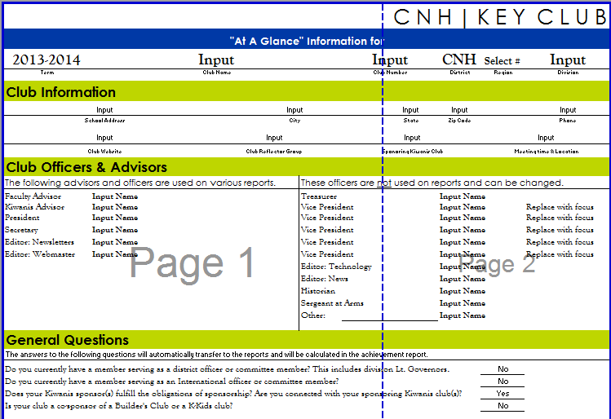
Step 1
This is the first task labeled.
Input basic information such as Club Name, Number, Region, and Division
Also add Club Information
Add information for advisors and officers
Answer the general questions at the bottom
Secretaries

Slide 15
Step 2: Club Roster
Within your MRF file, you need to complete all sections in the Roster tab
It is designed to help you when tracking service hours and during dues collection
ALWAYS keep a copy of the roster in your club records!
Secretaries

Slide 16
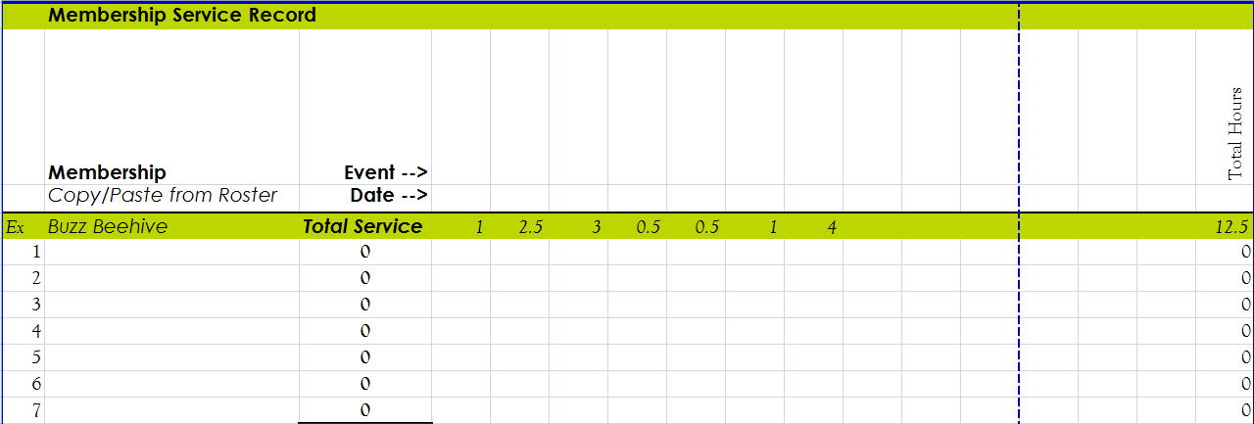
Step 3: Service Record
This tab helps you record the club members’ service hours. Use it to your advantage. It is not necessary, only helpful!
Add more columns BEFORE the last row to maintain the formula
Secretaries

Slide 17
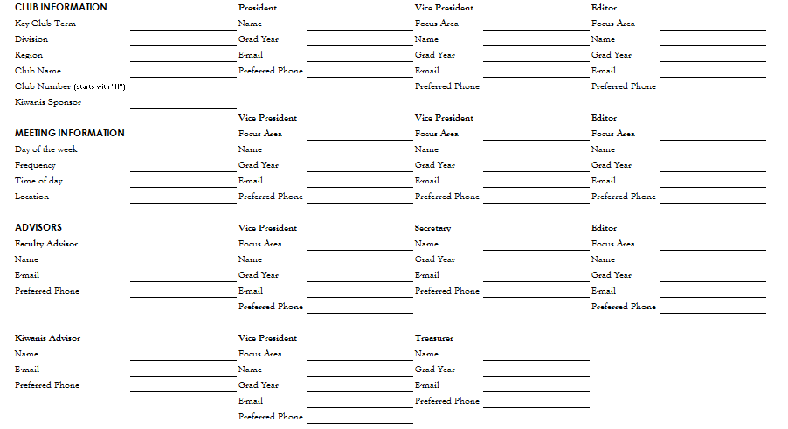
Step 4: CLUB ELECTIONS
Applies to newly elected officers
Secretaries

Slide 18
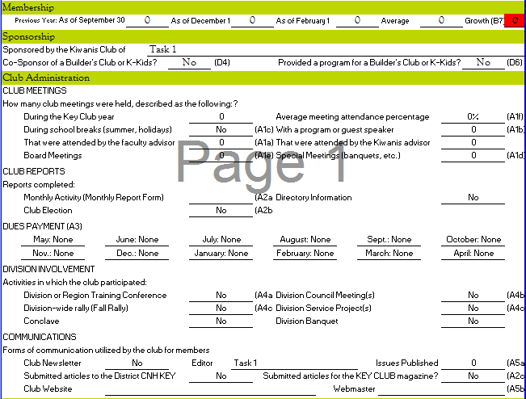
Step 5: Annual Achievement Report
Completed at the end of the term
Most data transfers from previous reports
Some questions must be answered manually
Submit to your LTG
Secretaries

Slide 19
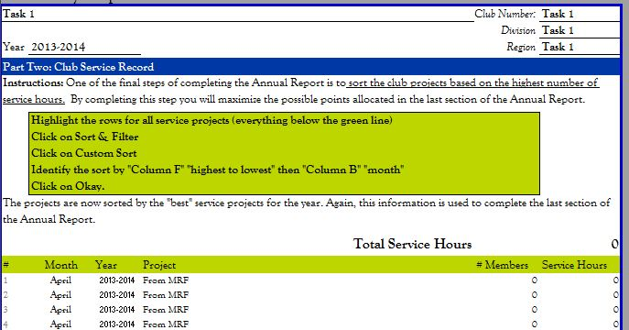
Step 6: Project List
Automatically transfers from monthly reports
Final step to generate the AAR score
Follow sorting directions on the MRF
Secretaries

Slide 20
Step 7: Monthly Report
Update each month
Data Report
Obtain meeting information from minutes
Mark whether sponsors met obligations
Fill out data from sign-in sheets and attendance records
Ask LTG for club’s current membership status
Project Report
Projects can be either service projects or fundraiserss
Socials can be included, but for no hours
Mark an “X” for each category of project that applies
Sort be descending # of hours
Secretaries

Slide 21
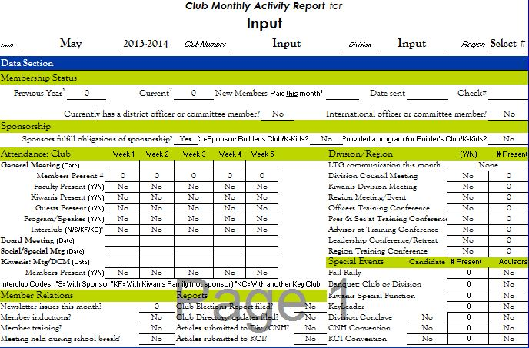
Secretaries

Slide 22
Club Snapshot
Monthly overview of your club
Project Snapshot
Description of projects and identification of project chair
Secretaries

Slide 23
Tips & Resources
Secretaries Workshop
Secretaries

Slide 24
Tips
Stay organized digitally and physically
Don’t procrastinate on MRFs!
Ask fellow officers and LTGs for clarifications and information
MRFs can be updated at any time (even past months)
Be on time to qualify for awards and recognition at DCON
Secretaries

Slide 25
Additional Resources
On the CyberKey
Secretaries Manual
Duties of the Club Secretary
And much more http://www.cnhkeyclub.org/officers/secretary
Key Club International
http://www.keyclub.org/Leadership/bal/leadclub/Clubsecretary.aspx
Secretaries Google Reflector
Advisors, Lt. Governors, and Executive Officers
Secretaries

