Slide 1
News Editor & Publicists
Tom Cheng, Division News Editor

Slide 2

STOP!
There will be a lot of useful information in the following slides
Please make
sure you are
taking notes! ☺

Slide 3

What do News Editors do?
Submit Articles and Visuals
Take pictures
Create Newsletters
Design flyers and posters
Publicize Key Club around your school and your community!

Slide 4
What we will go through:
Submissions
    Articles and Visuals
Publications
    What is a Newsletter?
    Creating Effective Newsletters
Graphic Standards
    Fonts, Logos, Pencils, Colors
Miscellaneous Topics

Slide 5
Submissions:
Articles and Visuals

Slide 6
Articles
Did you go to a fun Key Club event and want to write about your experience? Want to be heard all across the entire California-Nevada-Hawaii District?
Write an article using the template found on the CNH Website (www.cnhkeyclub.org) and email it to cnharticle@gmail.com
Anyone can write an article.
(encourage your club members!)
Make sure to send articles you receive to your DNE (Division News Editor) and/or Lt. Governor!

Slide 7
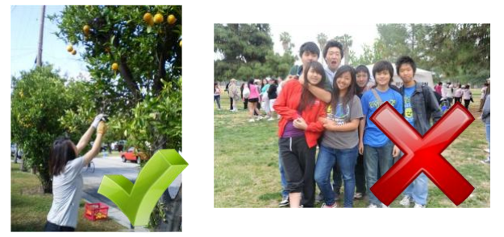
Taking Pictures: The right way.
Always have a camera ready at every event
If not, improvise! Cellphone cameras are decent nowadays.
When taking photos, put more emphasis on service!
Group photos and photos with your friends aren’t strictly prohibited, but
please refrain sending
these kinds of photos
to the district!

Slide 8
I have pictures, what now?
You can now send your pictures to your respective Lt. Governor and Division News Editor.
Send as many as you want! ☺
Your Lt. Governor will filter them and send them to the district.
Your Division News Editor can use them in division newsletters.
The district needs all photos and newsletters by the 20th of every month so turn in your pictures every 10th of the month!

Slide 9
Who do I send Articles and Visuals to?
cnharticle@gmail.com <- for articles
cnhvisuals@gmail.com <- visuals
You can also submit them to your Lt. Governor or DNE and they can submit them to the district for you!
Note: If you are submitting straight to the district, be sure to CC (carbon copy) your Lt. Governor and/or DNE so they have records of submissions for their monthly reports.
Help your DNE out! Write articles describing a memorable service event, or take pictures if you happen to bring your camera along! ☺

Slide 10
Publications

Slide 11
What are Newsletters?
A Newsletter is a tool that is commonly used to provide members updates regarding a division, district, etc.
They are used to promote upcoming events, service projects, feature old projects, and other useful information.
  As the name implies, they are letters that deliver news!

Slide 12
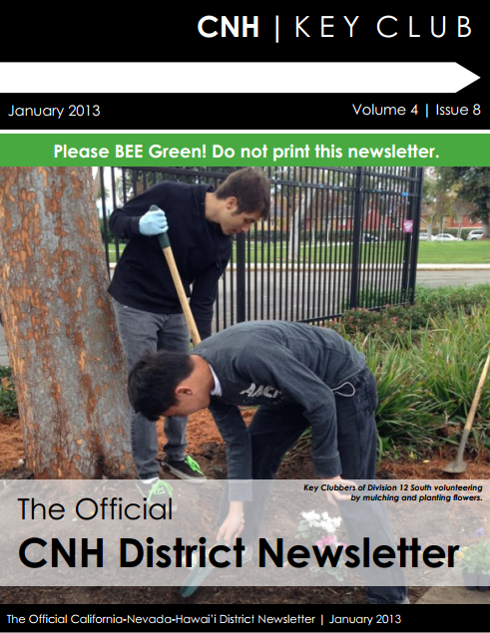
Newsletters
A newsletters are generally used to keep your club members updated on Key Club
You can incorporate more than just news, such as upcoming events or member of the month or even useful tips!
Newsletters should follow Graphic Standards
Example: Look to your right >

Slide 13
Graphic Standards

Slide 14
Why do we use Graphic Standards?
Graphic Standards: guidelines
  Flyers, newsletters, training material (like this slideshow), and other publications
Unity, consistency
Professionalism
Branding
  Allows work to be easily identified as part of Key Club. “The Key Club Branding”

Slide 15
Graphic Standards - Fonts
Century Gothic for headers
Goudy Old Style for body text
Alternatives fonts include Verdana and Arial
Use accent fonts to add your own style!
Find fonts online! www.dafont.com, www.urbanfonts.com
Always use the appropriate Key Club Logo, pencil, fonts, colors, and CNH logo
All logos and word marks must remain proportional

Slide 16




Graphic Standards - Logos
Basic Rules of use:
There should be nothing within a half inch of all sides of the Key Club logo and watermark.
The logo should also be on a neutral background
For more information, refer to the Graphic Standards manual
Max size: 1.5”
Max size: 5.0”

Slide 17
Graphic Standards - Pencils
Utilized as a header for many different Publications.
The pencil should be used on the front of all Key Club publications and on a regular 8.5”x11” paper should be no larger than 0.5” in height.
All pencils should reach from side to side on publications.
Should also be kept in a horizontal position pointing right (in most cases)
  No pencils pointing random directions!

Slide 18
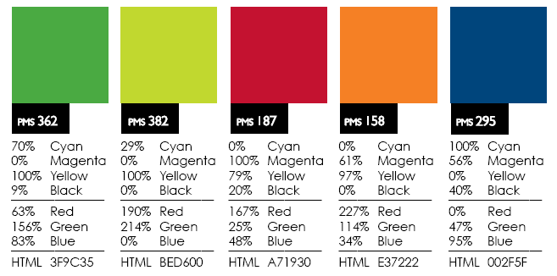
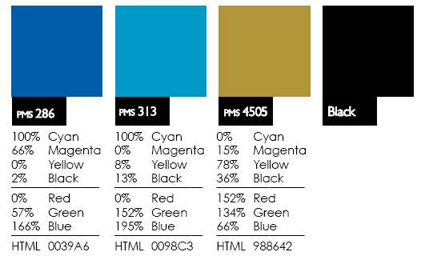
Graphic Standards - Colors
The following colors are the most commonly used when creating Key Club publications.
These colors are used to maintain the Key Club integrity and give it a more uniform look.

Slide 19
Miscellaneous
Topics

Slide 20
Optional Contests
There are many contests available for Bulletin Editors, Historians, and other Publicists:
  Club Newsletter
  Poster (Digital and Handmade)
  Key Club promotion video
  Club Website
  Scrapbooks (traditional, non-traditional, digital)
Interested? See the guidelines from last year’s applications on the CNH Website under Recognition>Contests.

Slide 21

Tips for Bulletin Editors
Plan early/ahead when dealing with submissions.
Communicate with club officers and members about articles and visuals.
Create personal deadlines.
Graphic Standards is KEY!
Don’t wait until your deadlines!
BEE on time!
Apply for Contests and
BEE Recognized!

Slide 22
More Resources
http://www.cnhkeyclub.org
http://www.keyclub.org
Copy of the Graphic Standards Manual
http://bit.ly/graphicstandardsmanual
Club Editor Duties Guideline
http://bit.ly/editorduties
Editor’s Reflector
http://groups.google.com/group/cnh-kc-editors
Editors Resource Pack: (compiled by Mark ☺)
http://bit.ly/editorspack/

Slide 23
QUIZ TIME!

Slide 24

Questions?
Go for it!
Please feel free to contact me!
Mark Ubongen
cnhkc.dne@gmail.com
markubongen@gmail.com

